Slide 1



A CENTER FOR INTER-DISCIPLINARY RESEARCH
2020-21
TITLE
“MOVIE RECOMMENDATIONS”
SUPERVISED BY
VANIMIREDDY RAM TEJA
GOKARAJU RANGARAJU
INSTITUTE OF ENGINEERING AND TECHNOLOGY
AUTONOMOUS

Slide 2
Advanced Academic Center
( A Center For Inter-Disciplinary Research )
This is to certify that the project titled
“MOVIE RECOMMENDATIONS”
is a bonafide work carried out by the following students in partial fulfilment of the requirements for Advanced Academic Center intern, submitted to the chair, AAC during the academic year 2020-21.
NAME | ROLL NO. | BRANCH
KOMMALA VISHNUVARDHAN | 20241A6625 | CSE(AIML)
KANCHI MISHRA | 20241A3228 | CSBS
SREYA SREE | 20241A339 | CSBS
MANASA KUMARI | 20241A237 | CSBS
G.RUTHVIK TARANG | 20241A3222 | CSBS
This work was not submitted or published earlier for any study
Dr/Ms./Mr.
Dr.B.R.K.Reddy
Program Coordinator
Dr.Ramamurthy Suri
Associate Dean,AAC
Project Supervisor

Slide 3
ACKNOWLEDGEMENTS
We express our deep sense of gratitude to our respected Director, Gokaraju Rangaraju Institute of Engineering and Technology, for the valuable guidance and for permitting us to carry out this project.
With immense pleasure, we extend our appreciation to our respected Principal, for permitting us to carry out this project.
We are thankful to the Associate Dean, Advanced Academic Centre, for providing us an appropriate environment required for the project completion.
We are grateful to our project supervisor who spared valuable time to influence us with their novel insights.
We are indebted to all the above mentioned people without whom we would not have concluded the project.

Slide 4
ABSTRACT Recommendation systems have become prevalent in recent years as they dealing with the information overload problem by suggesting users the most relevant products from a massive amount of data. For media product, online collaborative movie recommendations make attempts to assist users to access their preferred movies by capturing precisely similar neighbors among users or movies from their historical common ratings. However, due to the data sparsely, neighbor selecting is getting more difficult with the fast increasing of movies and users. In this paper, a hybrid model-based movie recommendation system which utilizes the improved K-means clustering coupled with genetic algorithms (GAs) to partition transformed user space is proposed. It employs principal component analysis (PCA) data reduction technique to dense the movie population space which could reduce the computation complexity in intelligent movie recom-mendation as well. The experiment results on Movielens dataset indicate that the proposed approach can provide high performance in terms of accuracy, and generate more reliable and personalized movie recommendations when compared with the existing methods.

Slide 5
MACHINE LARNING Machine learning is a tool for turning information into knowledge. In the past 50 years, there has been an explosion of data. This mass of data is useless unless we analyse it and find the patterns hidden within. Machine learning techniques are used to automatically find the valuable underlying patterns within complex data that we would otherwise struggle to discover. The hidden patterns and knowledge about a problem can be used to predict future events and perform all kinds of complex decision making. Most of us are unaware that we already interact with Machine Learning every single day. Every time we Google something, listen to a song or even take a photo, Machine Learning is becoming part of the engine behind it, constantly learning and improving from every interaction. It’s also behind world-changing advances like detecting cancer, creating new drugs and self-driving cars. Traditionally, software engineering combined human created rules with data to create answers to a problem. Instead, machine learning uses data and answers to discover the rules behind a problem. (Chollet, 2017) To learn the rules governing a phenomenon, machines have to go through a learning process, trying different rules and learning from how well they perform. Hence, why it’s known as Machine Learning. There are many approaches that can be taken when conducting Machine Learning. They are usually grouped into the areas listed below. Supervised Learning Unsupervised Learning Semi-supervised Learning Reinforcement Learning

Slide 6
Recommender Systems Recommender systems are defined as recommendation inputs given by the people, which the system then aggregates and directs to appropriate recipients. It can be further defined as a system that produces individualized recommendations as output or has the effect of guiding the user in a personalized way to interesting objects in a larger space of possible options. Recommender system will become an integral part of the Media and Entertainment industry in the near future. There are majorly six types of recommender systems which work primarily in the Media and Entertainment industry: Collaborative Recommender system, Content-based recommender system, Demographic based recommender system, Utility based recommender system, Knowledge based recommender system and hybrid recommended system. What is a movie Recommendation System? Simply put a movie Recommendation System is a filtration program whose prime goal is to predict the “rating” or “preference” of a user towards a domain-specific item or item. In our case, this domain-specific item is a movie, therefore the main focus of our recommendation system is to filter and predict only those movies which a user would prefer given some data about the user him or herself.

Slide 7
A) Content-Based Movie Recommendation Systems Content-based methods are based on the similarity of movie attributes. Using this type of recommender system, if a user watches one movie, similar movies are recommended. For example, if a user watches a comedy movie starring Adam Sandler, the system will recommend them movies in the same genre or starring the same actor, or both. With this in mind, the input for building a content-based recommender system is movie attributes. B) Collaborative Filtering Movie Recommendation Systems With collaborative filtering, the system is based on past interactions between users and movies. With this in mind, the input for a collaborative filtering system is made up of past data of user interactions with the movies they watch. For example, if user A watches M1, M2, and M3, and user B watches M1, M3, M4, we recommend M1 and M3 to a similar user C. You can see how this looks in the figure below for clearer reference. This data is stored in a matrix called the user-movie interactions matrix, where the rows are the users and the columns are the movies.

Slide 10
Scikit-Learn Scikit-learn is a library in Python that provides many unsupervised and supervised learning algorithms. It’s built upon some of the technology you might already be familiar with, like NumPy, pandas, and Matplotlib! The functionality that scikit-learn provides include: Regression, including Linear and Logistic Regression Classification, including K-Nearest Neighbors Clustering, including K-Means and K-Means++ Model selection Preprocessing, including Min-Max Normalization As you move through Codecademy’s Machine Learning content, you will become familiar with many of these terms. You will also see scikit-learn (in Python, sklearn) modules being used. For example:) >>sklearn.linear_model.LinearRegression is a Linear Regression model inside the linear_model module of sklearn.

Slide 11
Seaborn Seaborn is a data visualization library built on top of matplotlib and closely integrated with pandas data structures in Python. Visualization is the central part of Seaborn which helps in exploration and understanding of data. Seaborn offers the following functionalities:Dataset oriented API to determine the relationship between variables,Automatic estimation and plotting of linear regression plots,It supports high-level abstractions for multi-plot gridsandVisualizing univariate and bivariate distribution. These are only some of the functionalities offered by Seaborn, there are many more of them, and we can explore all of them here. To initialize the Seaborn library, the command used is: import seaborn as sns SciPy SciPy is a free and open-source Python library used for scientific computing and technical computing.^{[4]} SciPy contains modules for optimization, linear algebra, integration, interpolation, special functions, FFT, signal and image processing, ODE solvers and other tasks common in science and engineering. SciPy is also a family of conferences for users and developers of these tools: SciPy (in the United States), EuroSciPy (in Europe) and SciPy.in (in India).^{[5]} Enthought originated the SciPy conference in the United States and continues to sponsor many of the international conferences as well as host the SciPy website. The SciPy library is currently distributed under the BSD license, and its development is sponsored and supported by an open community of developers. It is also supported by NumFOCUS, a community foundation for supporting reproducible and accessible science.

Slide 12
Introduction to Clustering It is basically a type of unsupervised learning method . An unsupervised learning method is a method in which we draw references from datasets consisting of input data without labelled responses. Generally, it is used as a process to find meaningful structure, explanatory underlying processes, generative features, and groupings inherent in a set of examples. Clustering is the task of dividing the population or data points into a number of groups such that data points in the same groups are more similar to other data points in the same group and dissimilar to the data points in other groups. It is basically a collection of objects on the basis of similarity and dissimilarity between them. Add picture DBSCAN: Density-based Spatial Clustering of Applications with Noise These data points are clustered by using the basic concept that the data point lies within the given constraint from the cluster centre. Various distance methods and techniques are used for calculation of the outliers Why Clustering ? Clustering is very much important as it determines the intrinsic grouping among the unlabeled data present. There are no criteria for a good clustering. It depends on the user, what is the criteria they may use which satisfy their need. For instance, we could be interested in finding representatives for homogeneous groups (data reduction), in finding “natural clusters” and describe their unknown properties (“natural” data types), in finding useful and suitable groupings (“useful” data classes) or in finding unusual data objects (outlier detection). This algorithm must make some assumptions which constitute the similarity of points and each assumption make different and equally valid clusters.

Slide 13
Clustering Algorithms : K-means clustering algorithm – It is the simplest unsupervised learning algorithm that solves clustering problem.K-means algorithm partition n observations into k clusters where each observation belongs to the cluster with the nearest mean serving as a prototype of the cluster . KNN Algorithm K-Nearest Neighbour is one of the simplest Machine Learning algorithms based on Supervised Learning technique.K-NN algorithm assumes the similarity between the new case/data and available cases and put the new case into the category that is most similar to the available categories.K-NN algorithm stores all the available data and classifies a new data point based on the similarity. This means when new data appears then it can be easily classified into a well suite category by using K- NN algorithm. K-NN algorithm can be used for Regression as well as for Classification but mostly it is used for the Classification problems How does K-NN work? The K-NN working can be explained on the basis of the below algorithm: Step-1: Select the number K of the neighbors Step-2: Calculate the Euclidean distance of K number of neighbors Step-3: Take the K nearest neighbors as per the calculated Euclidean distance. Step-4: Among these k neighbors, count the number of the data points in each category. Step-5: Assign the new data points to that category for which the number of the neighbor is maximum. Step-6: Our model is ready.

Slide 14
How to select the value of K in the K-NN Algorithm? Below are some points to remember while selecting the value of K in the K-NN algorithmNext Stay There is no particular way to determine the best value for "K", so we need to try some values to find the best out of them. The most preferred value for K is 5. A very low value for K such as K=1 or K=2, can be noisy and lead to the effects of outliers in the model. Large values for K are good, but it may find some difficulties. Advantages of KNN Algorithm: It is simple to implement. It is robust to the noisy training data It can be more effective if the training data is large. Disadvantages of KNN Algorithm: Always needs to determine the value of K which may be complex some time. The computation cost is high because of calculating the distance between the data points for all the training samples.

Slide 16
CODE: import pandas as pd import numpy as np from scipy.sparse import csr_matrix from sklearn.neighbors import NearestNeighbors import matplotlib.pyplot as plt import seaborn as sns movies = pd.read_csv("movies.csv") ratings = pd.read_csv("ratings.csv") movies.head() ratings.head() final_dataset = ratings.pivot(index='movieId',columns='userId',values='rating') final_dataset.head() final_dataset.fillna(0,inplace=True) final_dataset.head() no_user_voted = ratings.groupby('movieId')['rating'].agg('count') no_movies_voted = ratings.groupby('userId')['rating'].agg('count') f,ax = plt.subplots(1,1,figsize=(16,4)) plt.scatter(no_user_voted.index,no_user_voted,color='mediumseagreen') plt.axhline(y=10,color='r') plt.xlabel('MovieId') plt.ylabel('No. of users voted') plt.show()

Slide 17
final_dataset = final_dataset.loc[no_user_voted[no_user_voted > 10].index,:] f,ax = plt.subplots(1,1,figsize=(16,4)) plt.scatter(no_movies_voted.index,no_movies_voted,color='mediumseagreen') plt.axhline(y=50,color='r') plt.xlabel('UserId') plt.ylabel('No. of votes by user') plt.show() final_dataset=final_dataset.loc[:,no_movies_voted[no_movies_voted > 50].index] final_dataset sample = np.array([[0,0,3,0,0],[4,0,0,0,2],[0,0,0,0,1]]) sparsity = 1.0 - ( np.count_nonzero(sample) / float(sample.size) ) print(sparsity) csr_sample = csr_matrix(sample) print(csr_sample) csr_data = csr_matrix(final_dataset.values) final_dataset.reset_index(inplace=True) knn = NearestNeighbors(metric='cosine', algorithm='brute', n_neighbors=20, n_jobs=-1) knn.fit(csr_data) def get_movie_recommendation(movie_name): n_movies_to_reccomend = 10 movie_list = movies[movies['title'].str.contains(movie_name)]

Slide 18
if len(movie_list): movie_idx= movie_list.iloc[0]['movieId'] movie_idx = final_dataset[final_dataset['movieId'] == movie_idx].index[0] distances , indices = knn.kneighbors(csr_data[movie_idx],n_neighbors=n_movies_to_reccomend+1) rec_movie_indices = sorted(list(zip(indices.squeeze().tolist(),distances.squeeze().tolist())),key=lambda x: x[1])[:0:-1] recommend_frame = [] for val in rec_movie_indices: movie_idx = final_dataset.iloc[val[0]]['movieId'] idx = movies[movies['movieId'] == movie_idx].index recommend_frame.append({'Title':movies.iloc[idx]['title'].values[0],'Distance':val[1]}) df = pd.DataFrame(recommend_frame,index=range(1,n_movies_to_reccomend+1)) return df else: return "No movies found. Please check your input" get_movie_recommendation('search movie here')

Slide 19
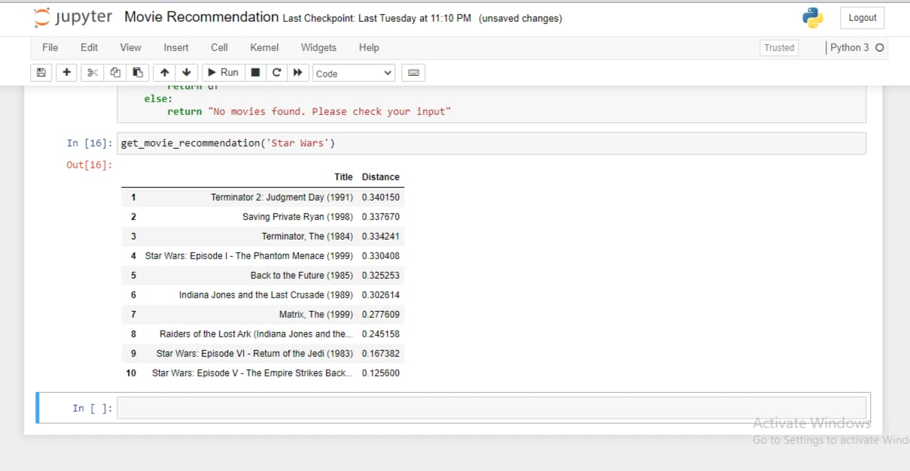
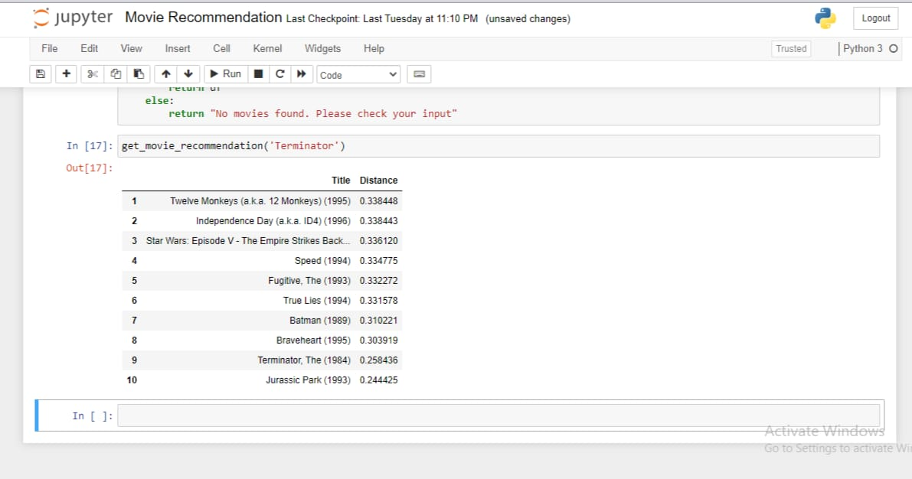
OUTPUT:

Slide 20
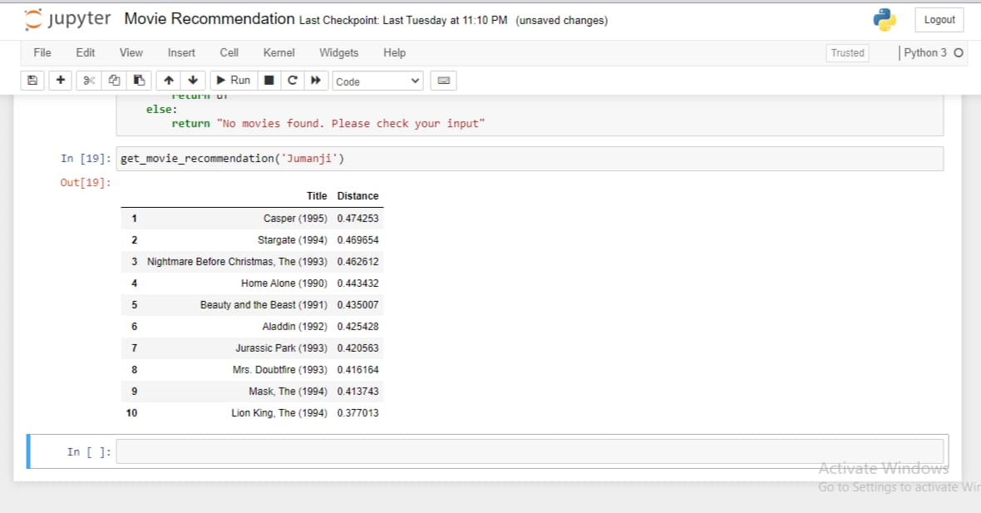
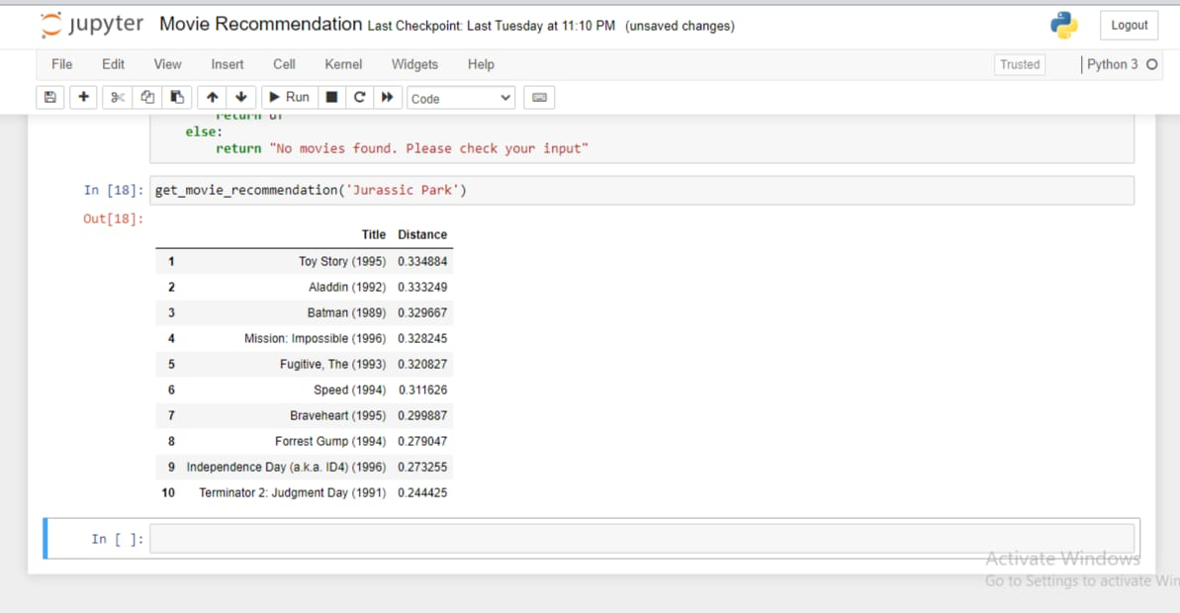

Slide 21
FUTURE DEVELOPMENTS Neural Networks and Deep Learning have been all the rage the last couple of years in many different fields, and it appears that they are also helpful for solving recommendation system problems. One of the benefits of Deep Learning is similar to matrix factorization, in that there is an ability to derive latent attributes. Deep Learning, however, can make up for some of the weaknesses of matrix factorization such as the inability to include time in the model — which standard matrix factorization isn’t designed for. Deep Learning, however, can utilize Recurrent Neural Networks which are specifically designed for time and sequence data. Incorporating time into a recommender system is important, because there are often preference seasonal effects. For example, it is likely that in December, more people are going to be watching holiday-themed movies and buying home decorations.Another point that can be taken under consideration is the need to see what would happen if a customer was shown a sub-optimal recommendation. This is taking a reinforcement learning approach, since the goal in this case would be to show customers a recommendation, and then record what the customer does. At times, customers can be recommended something that does not seem like the best option, just to see how the customer reacts which will improve the learning in the long-term.

Slide 22
REFRENCES: https://www.analyticsvidhya.com/blog/2020/11/create-your-own-movie-movie-recommendation-system https://towardsdatascience.com/how-to-build-a-movie-recommendation-system-67e321339109 https://www.javatpoint.com/k-nearest-neighbor-algorithm-for-machine-learning https://www.sciencedirect.com/topics/computer-science/cosine-similarity#:~:text=Cosine%20similarity%20measures%20the%20similarity,document%20similarity%20in%20text%20analysis https://www.geeksforgeeks.org/clustering-in-machine-learning

